Slide 1

307304 Business Intelligence and Data Mining
Simple Linear Regression

Slide 2
Topics and Learning Outcomes
What You'll Learn:
Introduce the concept of supervised learning
Understanding regression analysis fundamentals
Types of linear regression models
Best-fit line, hypothesis function, and OLS method
Closed-form solution implementation
Gradient descent algorithm
Linear regression assumptions
Evaluation metrics and performance assessment
Practical implementation with scikit-learn

Slide 3
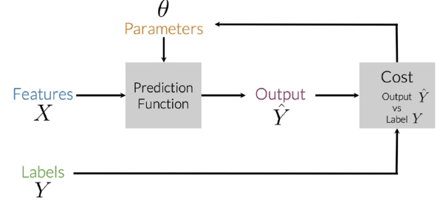
Supervised Machine Learning
Supervised machine learning is a type of learning where a model learns from labeled data.
The process follows these key steps:
Input Features (X): The model takes input data (features) which represents the information used to make predictions.
Prediction Function: The model, with some parameters (θ), processes the input data to generate predictions (Ŷ).
Output (Ŷ): This is the model’s prediction based on the input features.
Cost Function: The predicted output (Ŷ) is compared to the actual labels (Y) to calculate an error or "cost."
Optimization:
The model adjusts its parameters (θ) of the cost function to minimize the error, improving its predictions over time.
This process repeats iteratively until the model achieves good accuracy.
It's commonly used for tasks like classification (e.g., spam detection) and regression (e.g., predicting house prices).

Slide 4
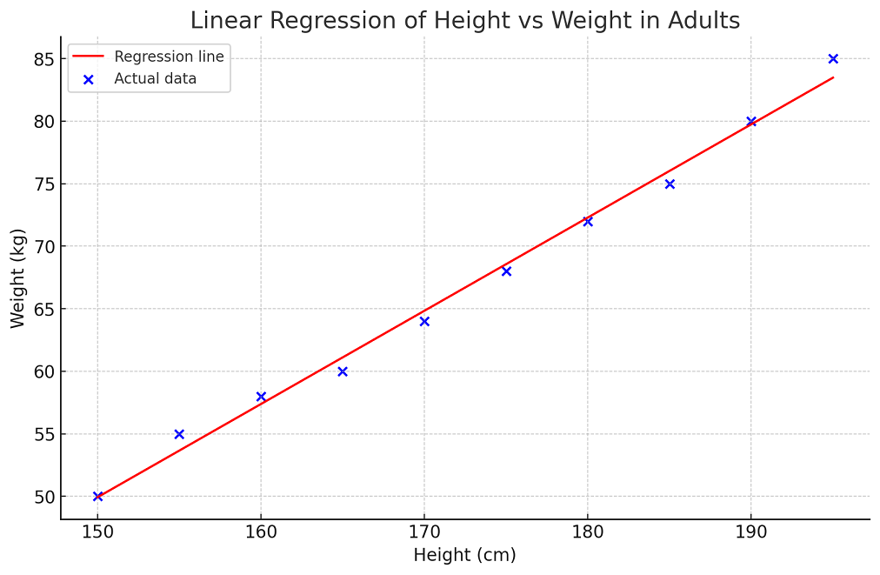
What is Regression Analysis?
Definition and Purpose
Linear Regression is a supervised machine learning algorithm that models the linear relationship between:
Dependent variable (target): What we want to predict
Independent variable(s) (features): What we use to make predictions
Key Concept: Fits a linear equation to observed data to make predictions on new, unseen data.
Real-World Applications:
Predicting house prices based on size
Estimating sales revenue from advertising spend
Forecasting stock prices using economic indicators

Slide 5
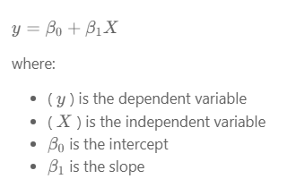
Types of Linear Regression
There are two main types of linear regression:
1- Simple Linear Regression
This is the simplest form of linear regression, and it involves only one independent variable and one dependent variable.
The equation for simple linear regression is:

Slide 6
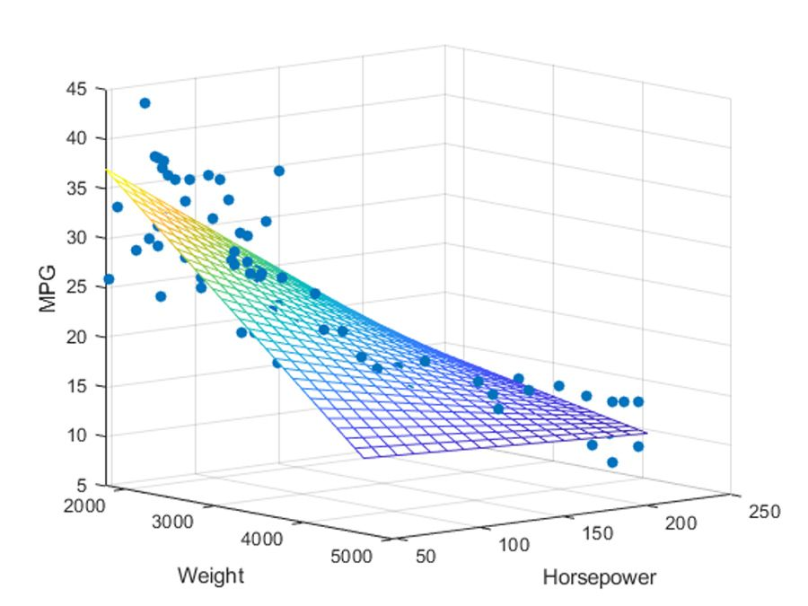
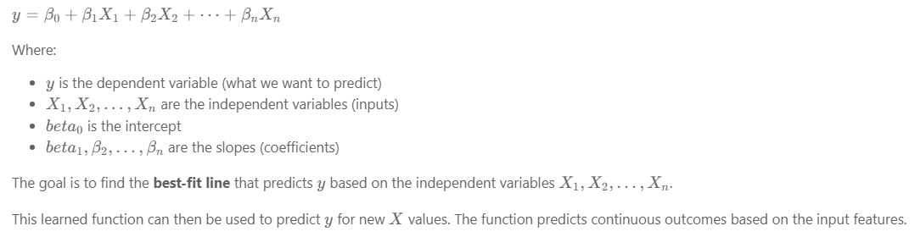
Types of Linear Regression
2- Multiple Linear Regression (Simplified)
In multiple linear regression, there is one dependent variable and more than one independent variable.
The equation is:

Slide 7
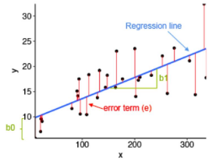
What is the Best Fit Line?
In linear regression, the best-fit line is the line that minimizes the error between the predicted and actual values.
It represents the relationship between the dependent and independent variables.
The goal is to change the slope and the intercept of the line to make the most accurate predictions.
Linear regression predicts Y based on X, using a straight line to model the relationship. For example, X could be work experience, and Y could be salary.
The goal is to find the best-fit line that minimizes the error between predicted and actual values.
To find this line, we use a cost function, which helps determine the best values for the line's coefficients.

Slide 8
Why Linear Regression Matters
Four Key Benefits:
Interpretability
Clear, understandable coefficients
Easy to explain relationships between variables
Simplicity
Transparent and easy to implement
Foundation for more complex algorithms
Basis for Advanced Models
Building block for regularization (Ridge, Lasso)
Foundation for support vector machines
Assumption Testing
Validates key data assumptions
Critical for statistical analysis

Slide 9
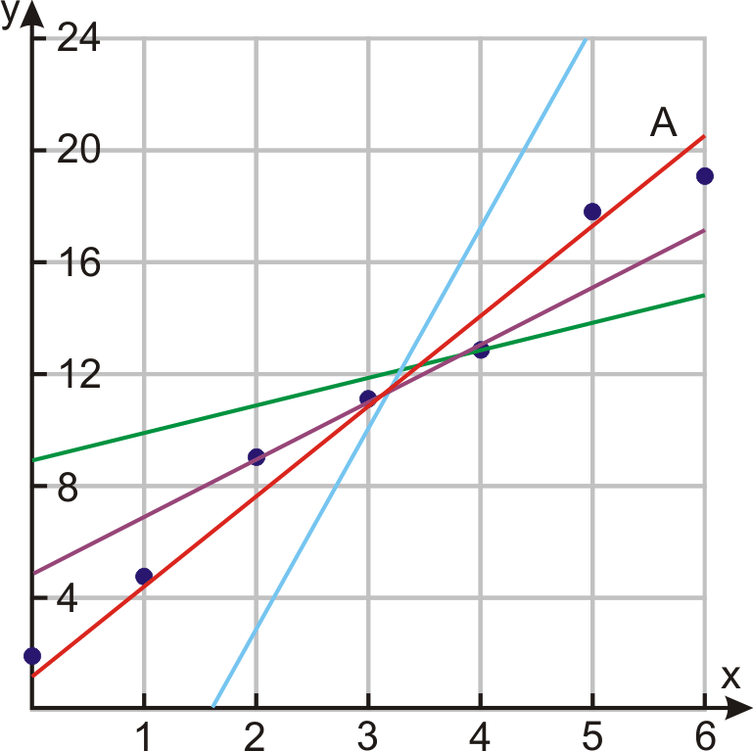
The Best-Fit Line Concept
What Makes a Line "Best-Fit"?
The best-fit line minimizes the error between predicted and actual values.
Key Components:
Slope (β₁): How much Y changes for each unit change in X
Intercept (β₀): Value of Y when X = 0
Goal: Find the line that makes the most accurate predictions
Mathematical Representation: Ŷ = β₀ + β₁X
Where Ŷ (pronounced Y Hat) is the predicted value.

Slide 10
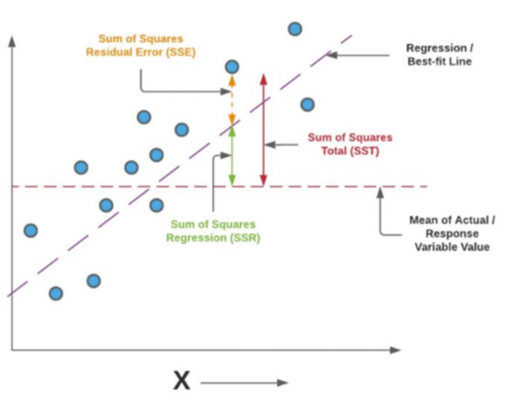
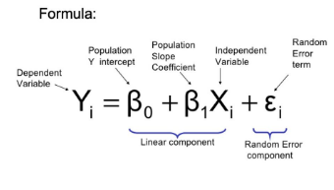
Ordinary Least Squares (OLS) Method
The Foundation of Linear Regression
OLS Principle: Find the line that minimizes the sum of squared differences between observed and predicted values.
Why "Least Squares"?
Squares prevent positive and negative errors from canceling out
Penalizes larger errors more heavily
Provides unique, mathematically optimal solution

Slide 11
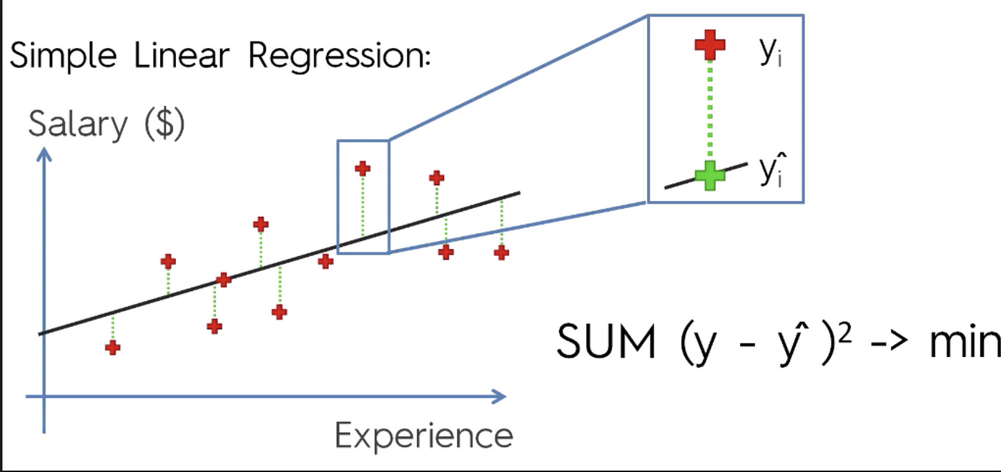

Cost Function - Mean Squared Error
Measuring Prediction Quality
The Mean Squared Error (MSE) quantifies how well our model performs.
Formula:
Key Points:
Lower MSE = Better model performance
Units are squared (e.g., dollars² for price prediction)
Always positive (due to squaring)
Heavily penalizes large errors

Slide 12
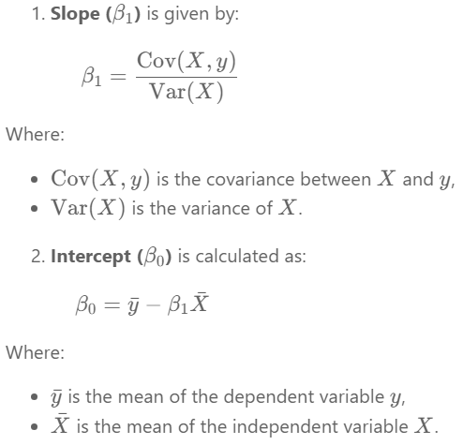

Solving Linear Regression with the Closed-Form Solution
The closed-form solution is efficient for small to medium-sized datasets, especially in simple linear regression, where slope and intercept can be computed directly without matrix operations.
However, for multiple linear regression, the closed-form solution involves computing the inverse of X^T.X, which becomes computationally expensive as dataset size and dimensionality grow.
It works well when:
The dataset is small (typically up to a few thousand rows).
The number of features is low.
There is no multicollinearity (i.e., features are not highly correlated).
For larger or more complex problems, iterative methods like Gradient Descent are preferred due to their scalability and efficiency.

Slide 13
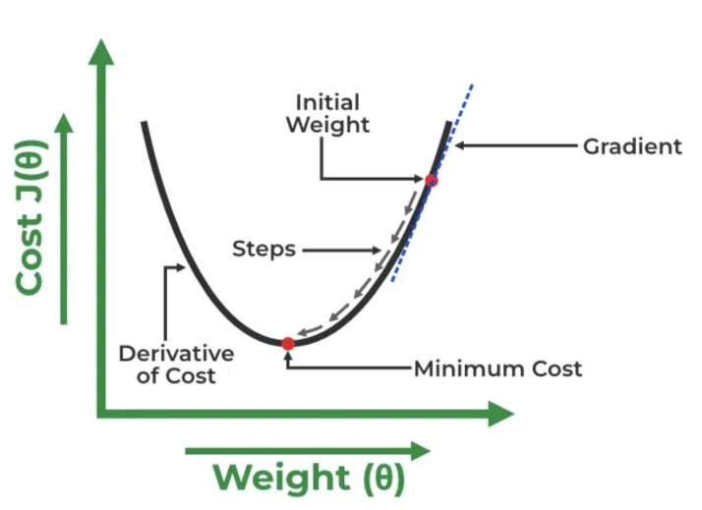
Solving Linear Regression Using The Gradient Descent Method
A linear regression model can be trained using Gradient Descent, which adjusts the model's parameters to minimize the mean squared error (MSE).
To update (Beta 0) and (Beta 1) and reduce the cost function (minimizing the RMSE), gradient descent starts with random values for (Beta 0) and (Beta 1) and iteratively improves them to find the best-fit line.
A gradient is simply the derivative, showing how small changes in inputs affect the output.
By moving in the direction of the Mean Squared Error negative gradient with respect to the coefficients, the coefficients can be changed.

Slide 16
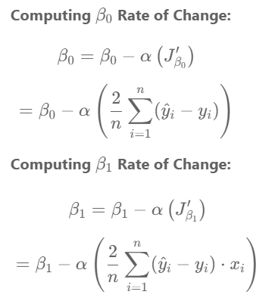
Solving Linear Regression Using The Gradient Descent Method

Slide 17
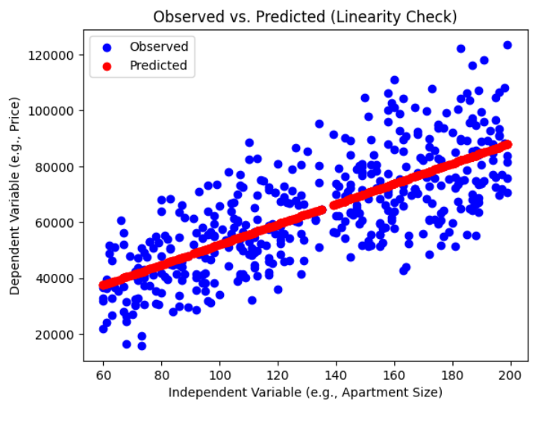
Assumptions of Simple Linear Regression
Linear regression is a powerful tool for understanding and predicting the behavior of a variable, however, it needs to meet a few conditions in order to be accurate and dependable solutions.
1. Linearity: The independent and dependent variables have a linear relationship with one another. This implies that changes in the dependent variable follow those in the independent variable(s) in a linear fashion. This means that there should be a straight line that can be drawn through the data points. If the relationship is not linear, then linear regression will not be an accurate model.

Slide 18
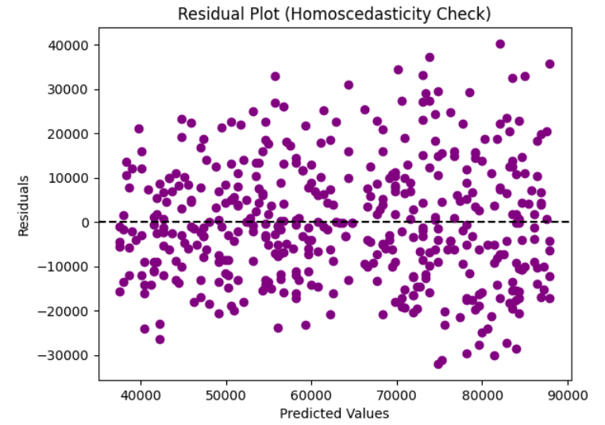
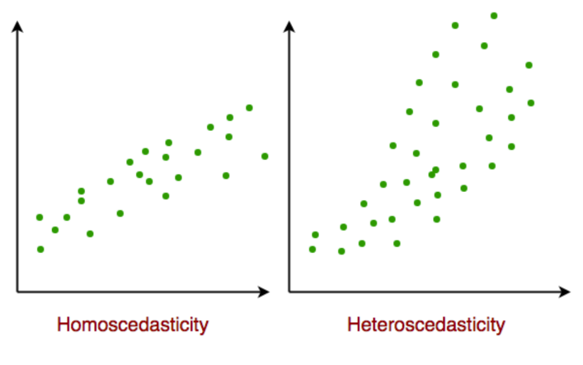
Assumptions of Simple Linear Regression
2. Independence: The observations in the dataset must be independent, meaning the value of the dependent variable for one observation should not be influenced by the value of another. If this condition is violated, linear regression may produce inaccurate results.
3. Homoscedasticity: The variance of the errors should be constant across all levels of the independent variable(s). This means that changes in the independent variable(s) should not affect the spread of the errors. If the error variance is not constant (heteroscedasticity), the linear regression model may not be reliable.

Slide 19
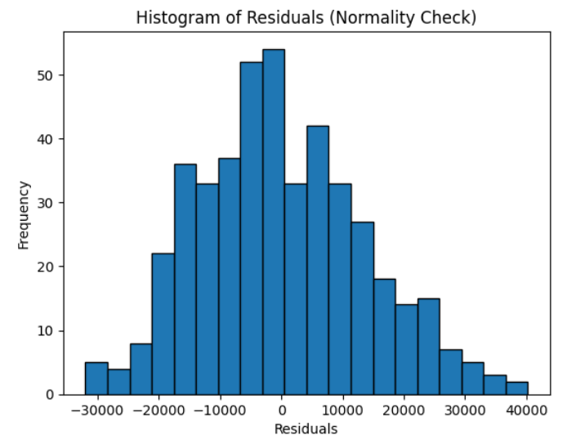
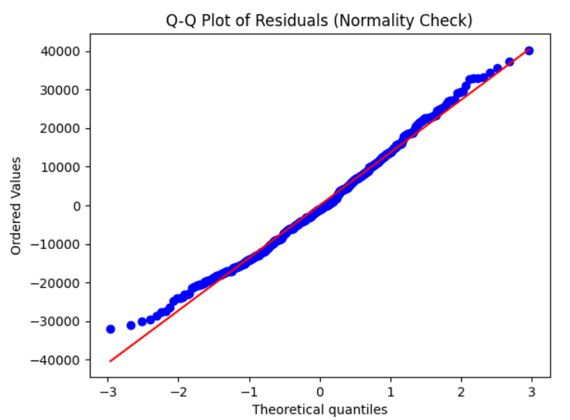
Assumptions of Simple Linear Regression
4. Normality: The residuals should be normally distributed. This means that the residuals should follow a bell-shaped curve. If the residuals are not normally distributed, then linear regression will not be an accurate model.

Slide 20
Assumptions of Simple Linear Regression
5. No Multicollinearity
The independent variables should not be highly correlated with each other.
Multicollinearity occurs when two or more independent variables are strongly related, making it difficult to isolate the effect of each variable on the dependent variable.
If multicollinearity exists, it can lead to inaccurate results in multiple linear regression.
For multiple linear regression, multicollinearity among independent variables can be assessed using the Variance Inflation Factor (VIF). A VIF value greater than 10 indicates high multicollinearity.

Slide 21
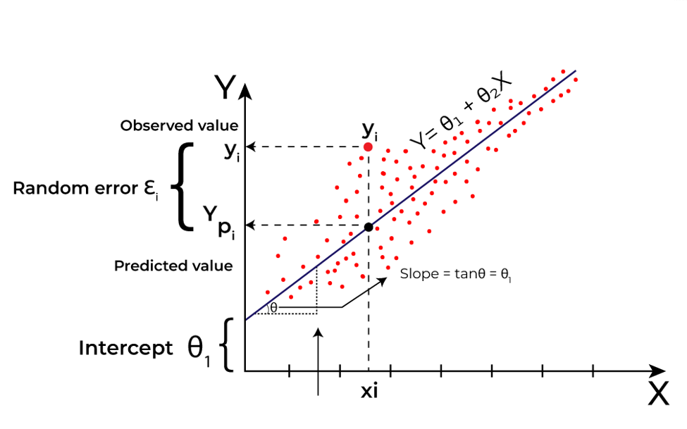
What is Regressions Analysis?
Linear regression is a type of supervised machine learning algorithm that computes the linear relationship between a dependent variable and one or more independent variables by fitting a linear equation that models the relationship between these variables.
In LR, we use a linear formula in the form of:
Y = B0 + B1X
to represent the relationship between an independent variable (X) and a dependent variable (Y).
In LR, both X and Y are numerical values, for example, X could be the employee’s years of experience and Y could be his predicted salary, and we use LR to model that relation.

